Slide 1
Database Systems
Lecture 14
Specialization and generalization

Slide 2
Today’s Agenda
Specialization
Generalization
Constraints on specialization and generalization

Slide 3
Specialization
Is the process of defining a set of subclasses of a superclass
The set of subclasses is based upon some distinguishing characteristics of the entities in the superclass
Example: {SECRETARY, ENGINEER, TECHNICIAN} is a specialization of EMPLOYEE based upon job type.
May have several specializations of the same superclass
Example: Another specialization of EMPLOYEE based in method of pay is {SALARIED_EMPLOYEE, HOURLY_EMPLOYEE}.
Superclass/subclass relationships and specialization can be diagrammatically represented in EER diagrams
Attributes of a subclass are called specific attributes. For example, TypingSpeed of SECRETARY
The subclass can participate in specific relationship types. For example, BELONGS_TO of HOURLY_EMPLOYEE

Slide 4
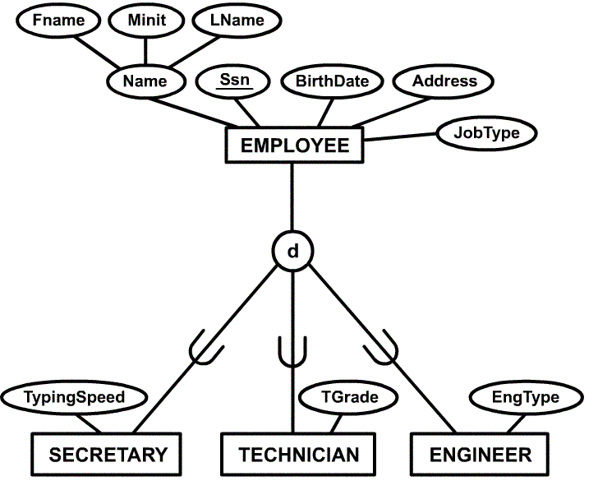
Example of a Specialization

Slide 5
Specialization (cont)
The specialization process allows us to do the following:
Define a set of subclasses of an entity type
Establish additional specific attributes with each subclass
Establish additional specific relationship types between each subclass and other entity types or other subclasses

Slide 6
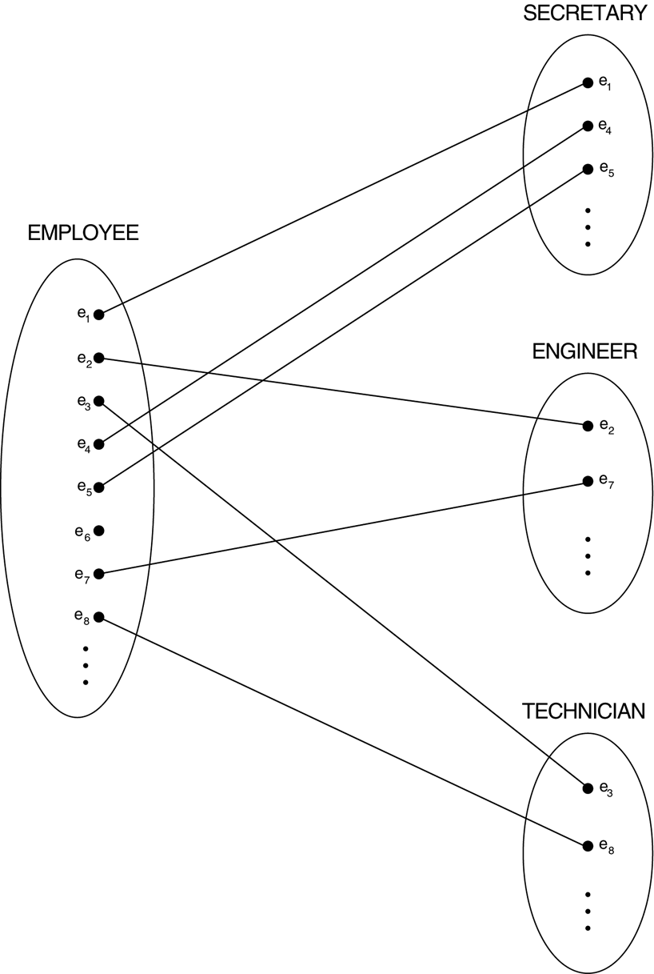
Instances of a specialization

Slide 7
Generalization
The reverse of the specialization process
Several classes with common features are generalized into a superclass; original classes become its subclasses
Example: CAR, TRUCK generalized into VEHICLE; both CAR, TRUCK become subclasses of the superclass VEHICLE.
We can view {CAR, TRUCK} as a specialization of VEHICLE
Alternatively, we can view VEHICLE as a generalization of CAR and TRUCK

Slide 8
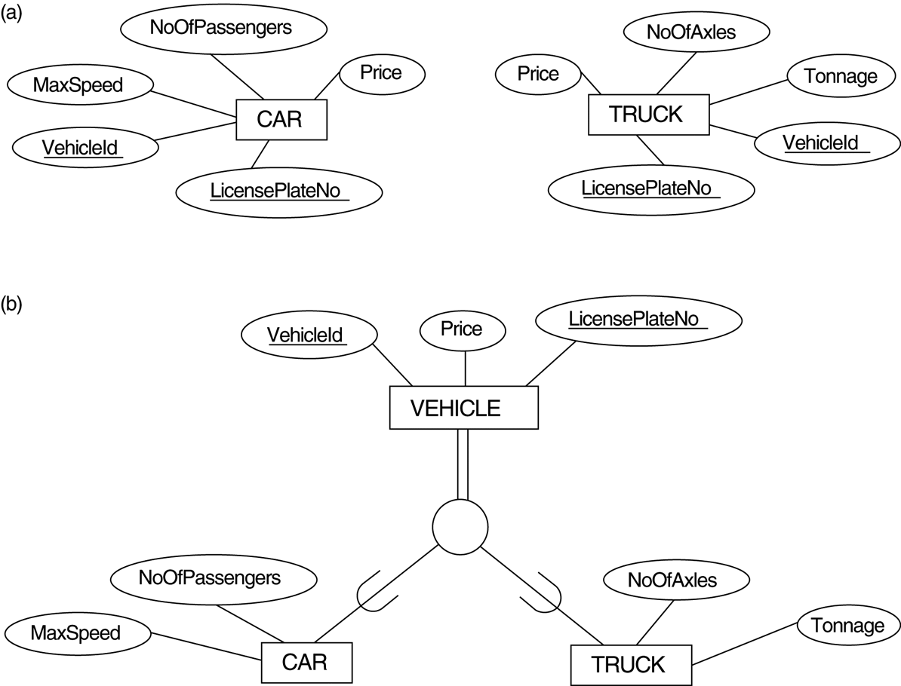
Generalization. (a) Two entity types, CAR and TRUCK. (b) Generalizing CAR and TRUCK into the superclass VEHICLE.

Slide 9
Generalization and Specialization
Diagrammatic notation sometimes used to distinguish between generalization and specialization
Arrow pointing to the generalized superclass represents a generalization
Arrows pointing to the specialized subclasses represent a specialization
We do not use this notation because it is often subjective as to which process is more appropriate for a particular situation
We advocate not drawing any arrows in these situations
Data Modeling with Specialization and Generalization
A superclass or subclass represents a set of entities
Shown in rectangles in EER diagrams (as are entity types)
Sometimes, all entity sets are simply called classes, whether they are entity types, superclasses, or subclasses

Slide 10
Constraints on Specialization and Generalization
Constraints that apply to a single specialization or a single generalization.
Our discussion refers only to specialization even though it applies to both specialization and generalization.
Differences between specialization and generalization lattices (multiple inheritance) and hierarchies (single inheritance),

Slide 11
Constraints on Specialization and Generalization (cont)
If we can determine exactly those entities that will become members of each subclass by a condition, the subclasses are called predicate-defined (or condition-defined) subclasses
Condition is a constraint that determines subclass members (defining predicate)
Display a predicate-defined subclass by writing the predicate condition next to the line attaching the subclass to its superclass
If all subclasses in a specialization have membership condition on same attribute of the superclass, specialization is called an attribute defined-specialization
Attribute is called the defining attribute of the specialization
Example: JobType is the defining attribute of the specialization
{SECRETARY, TECHNICIAN, ENGINEER} of EMPLOYEE
If no condition determines membership, the subclass is called user-defined
Membership in a subclass is determined by the database users by applying an operation to add an entity to the subclass
Membership in the subclass is specified individually for each entity in the superclass by the user

Slide 12
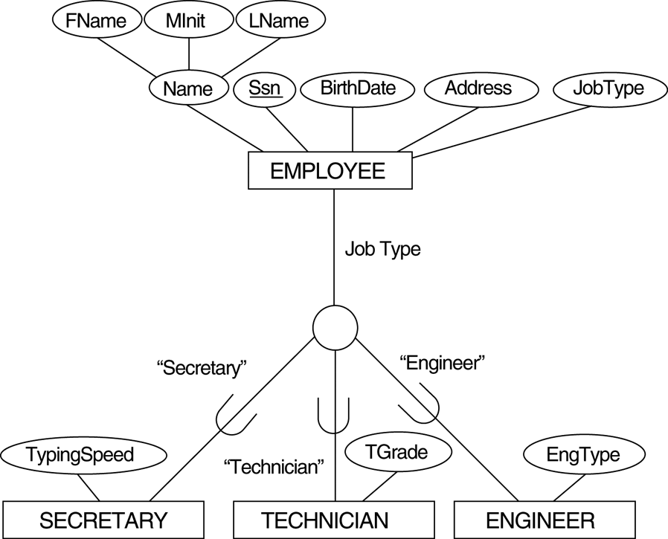
EER diagram notation for an attribute-defined specialization on JobType
d

Slide 13
Constraints on Specialization and Generalization (cont)
Two other conditions apply to a specialization/generalization:
Disjointness Constraint:
Specifies that the subclasses of the specialization must be disjointed (an entity can be a member of at most one of the subclasses of the specialization)
Specified by d in EER diagram
If not disjointed, overlap; that is the same entity may be a member of more than one subclass of the specialization
Specified by o in EER diagram
Completeness Constraint:
Total specifies that every entity in the superclass must be a member of some subclass in the specialization/ generalization
Shown in EER diagrams by a double line
Partial allows an entity not to belong to any of the subclasses
Shown in EER diagrams by a single line

Slide 14
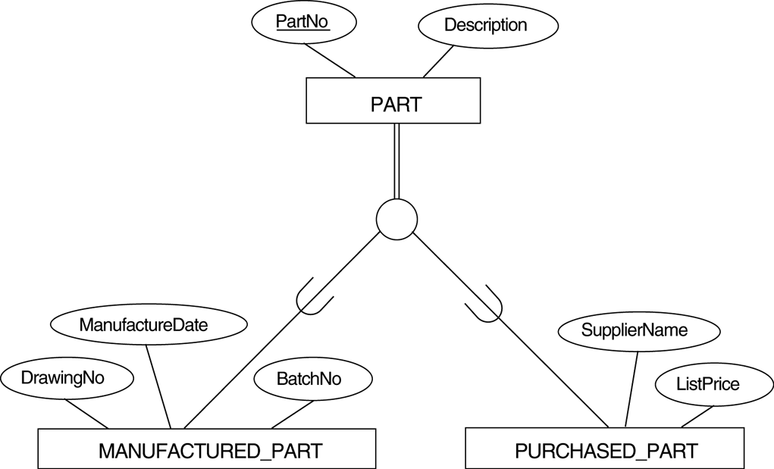
EER diagram notation for an overlapping (nondisjoint) specialization.
O

Slide 15
Constraints on Specialization and Generalization (cont)
Disjointness and completeness constraints are independent.
We have four possible types of specialization/generalization:
Disjoint, total
Disjoint, partial
Overlapping, total
Overlapping, partial
Note: Generalization usually is total because the superclass is derived from the subclasses.

Slide 16
Constraints on Specialization and Generalization (cont)
Certain insertion and deletion rules apply to specialization (and generalization) as a consequence of the constraints specified earlier. Some of these rules are as follows:
Deleting an entity from a superclass implies that it is automatically deleted from all the subclasses to which it belongs.
Inserting an entity in a superclass implies that the entity is mandatorily inserted in all predicate-defined (or attribute-defined) subclasses for which the entity satisfies the defining predicate.
Inserting an entity in a superclass of a total specialization implies that the entity is mandatorily inserted in at least one of the subclasses of the specialization.

Slide 17
Specialization / Generalization Hierarchies, Lattices and Shared Subclasses (1)
A subclass may itself have further subclasses specified on it
Forms a hierarchy or a lattice
Hierarchy has a constraint that every subclass has only one superclass (called single inheritance)
In a lattice, a subclass can be subclass of more than one superclass (called multiple inheritance)
In a lattice or hierarchy, a subclass inherits attributes not only of its direct superclass, but also of all its predecessor superclasses

Slide 18
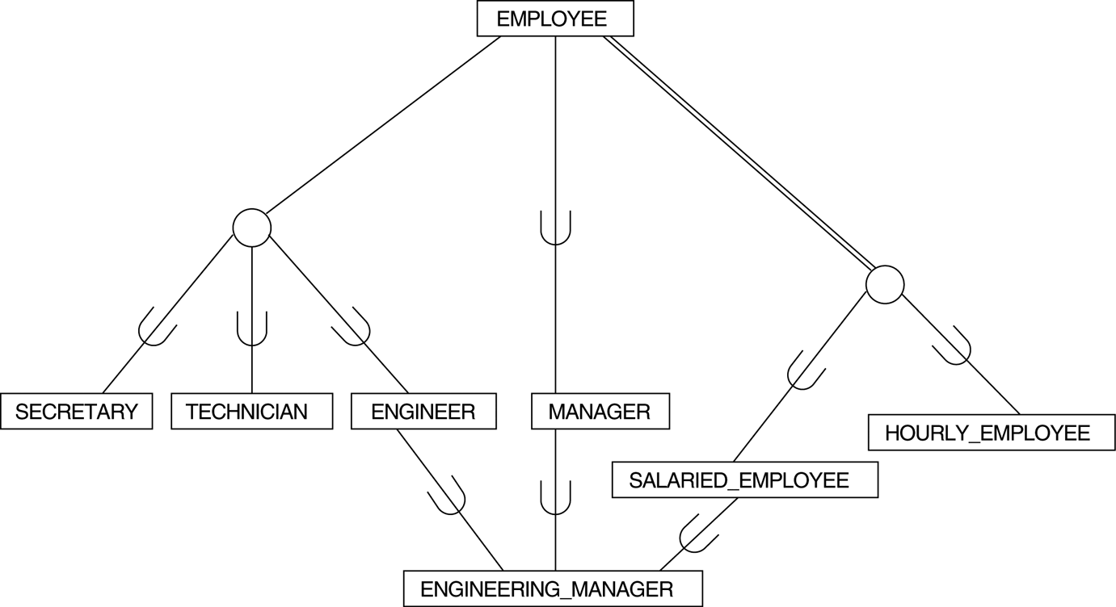
A specialization lattice with shared subclass ENGINEERING_MANAGER.
d
d

Slide 19
Specialization / Generalization Hierarchies, Lattices and Shared Subclasses (2)
A subclass with more than one superclass is called a shared subclass
Can have specialization hierarchies or lattices, or generalization hierarchies or lattices
In specialization, start with an entity type and then define subclasses of the entity type by successive specialization (top down conceptual refinement process)
In generalization, start with many entity types and generalize those that have common properties (bottom up conceptual synthesis process)
In practice, the combination of two processes is employed

Slide 20
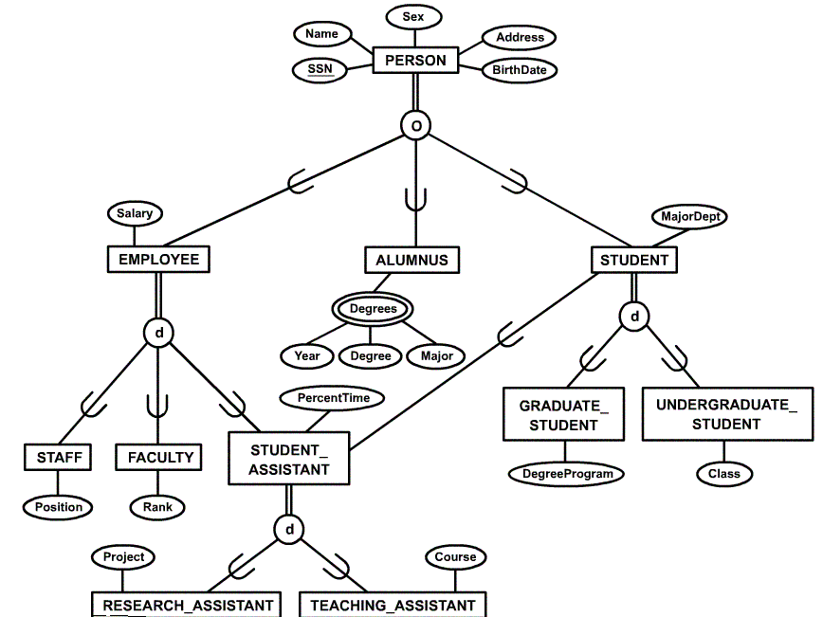
Specialization / Generalization Lattice Example (UNIVERSITY)

